Slide 1

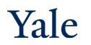
Deep Learning Theory and Applications Unsupervised Learning and Autoencoders
CPSC 452/552
CBB/AMTH 663

Slide 2
Outline
Unsupervised Learning
PCA
Non-linear dimensionality reduction
Autoencoders

Slide 3

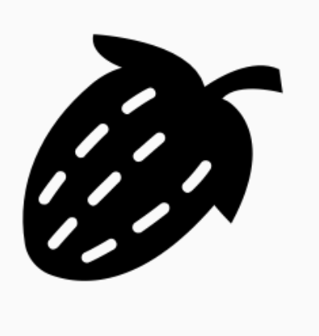



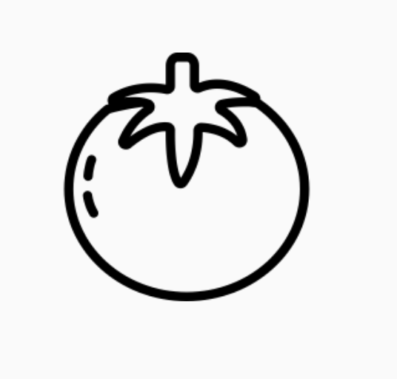

Two kinds of machine learning
Supervised learning
Have a bunch of labelled data, want to label new data
Unsupervised learning
Have a bunch of unlabeled data, want to organize it
Supervised Learning Model
Unsupervised Learning Model
Strawberry
Noun project
Notes:
Differentiate between supervised and unsupervised learning, left figure should have the label strawberry as output, right figure should also just have one image but it should have maybe a couple of vectors (of numbers) as output

Slide 4
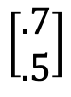
Two kinds of machine learning
Supervised learning
Have a bunch of labelled data, want to label new data
Unsupervised learning
Have a bunch of unlabeled data, want to organize it
Supervised Learning Model
Unsupervised Learning Model
Strawberry
$$\left[\begin{matrix}.7 \\ .5\end{matrix}\right]$$
Noun project
Notes:
Differentiate between supervised and unsupervised learning, left figure should have the label strawberry as output, right figure should also just have one image but it should have maybe a couple of vectors (of numbers) as output

Slide 5
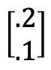
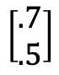
Two kinds of machine learning
Supervised learning
Have a bunch of labelled data, want to label new data
Unsupervised learning
Have a bunch of unlabeled data, want to organize it
Supervised Learning Model
Unsupervised Learning Model
Strawberry
$$\left[\begin{aligned}.2 \\ .1\end{aligned}\right]$$
$$\left[\begin{aligned}.7 \\ .5\end{aligned}\right]$$
Noun project
Notes:
Differentiate between supervised and unsupervised learning, left figure should have the label strawberry as output, right figure should also just have one image but it should have maybe a couple of vectors (of numbers) as output

Slide 6
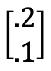
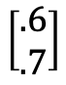
Two kinds of machine learning
Supervised learning
Have a bunch of labelled data, want to label new data
Unsupervised learning
Have a bunch of unlabeled data, want to organize it
Supervised Learning Model
Unsupervised Learning Model
$$\left[\begin{aligned}.2 \\ .1\end{aligned}\right]$$
Strawberry
$$\left[\begin{aligned}.6 \\ .7\end{aligned}\right]$$
$$\left[\begin{aligned}.7 \\ .5\end{aligned}\right]$$
Noun project
Notes:
Differentiate between supervised and unsupervised learning, left figure should have the label strawberry as output, right figure should also just have one image but it should have maybe a couple of vectors (of numbers) as output

Slide 7
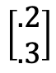
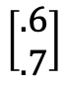
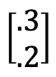
Two kinds of machine learning
Supervised learning
Have a bunch of labelled data, want to label new data
Unsupervised learning
Have a bunch of unlabeled data, want to organize it
Supervised Learning Model
Unsupervised Learning Model
$$\left[\begin{aligned}.3 \\ .2\end{aligned}\right]$$
$$\left[\begin{aligned}.2 \\ .1\end{aligned}\right]$$
$$\left[\begin{aligned}.2 \\ .3\end{aligned}\right]$$
Strawberry
$$\left[\begin{aligned}.7 \\ .5\end{aligned}\right]$$
$$\left[\begin{aligned}.6 \\ .7\end{aligned}\right]$$
Noun project
Notes:
Differentiate between supervised and unsupervised learning, left figure should have the label strawberry as output, right figure should also just have one image but it should have maybe a couple of vectors (of numbers) as output

Slide 8
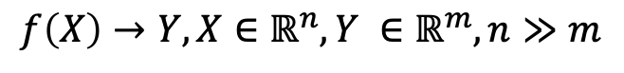
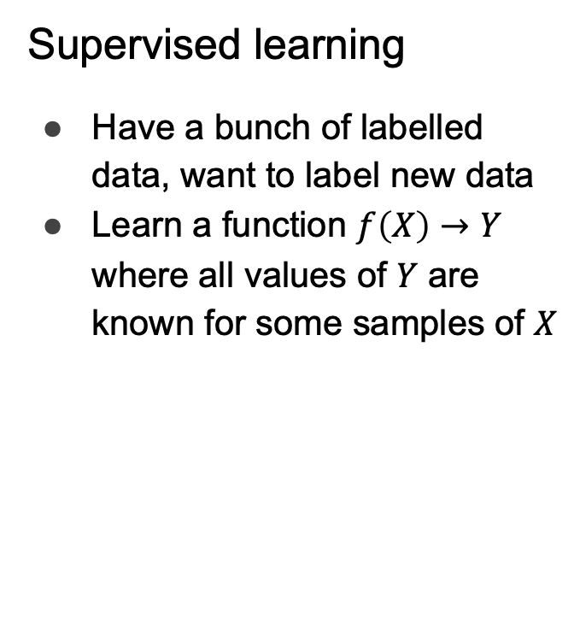
Two kinds of machine learning
Supervised learning
Have a bunch of labelled data, want to label new data
Learn a function $f\left(X\right)→Y$ where all values of $Y$ are known for some samples of $X$
Unsupervised learning
Have a bunch of unlabeled data, want to organize it
Learn an embedding
Lower dimensional, easier to interpret (e.g. as clusters)
$$f\left(X\right)→Y, X∈ℝ^{n},Y ∈ℝ^{m}, n≫m$$
Supervised Learning Model
Unsupervised Learning Model
Noun project
Notes:
Carry the change to the figures

Slide 9
Unsupervised learning
Dataset contains only features and no labels
Goal is to find hidden patterns in the unlabeled data
Examples
Density estimation
Data generation
Clustering
Data denoising
Representation learning
Semi-supervised learning attempts to combine information from both labeled and unlabeled data to deduce information
Notes:
What might this be useful for?

Slide 10
Representation learning
Find the “best” representation of the data
I.e., find a representation of the data that preserves as much information as possible while obeying some penalty or constraint that simplifies the representation
What information do we want to preserve?
How do we define simple?
Low-dimensional
Sparse
Independent components
Above criteria aren’t necessarily mutually exclusive
E.g., low-dimensional representations often have independent or weakly dependent components
Notes:
These criteria aren’t necessarily mutually exclusive

Slide 11
Representation learning
Why is a simple representation useful?
Interpretability
E.g. visualization
Computational cost
Compression
Performance
Preprocessing
Notes:
Mention that for computational cost, this can include memory and storage

Slide 12
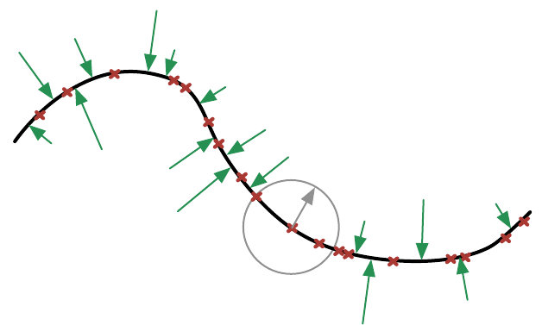
Manifold assumption
Data may be modeled as lying on a low-dimensional manifold
Notes:
Can model the actual data as lying on a low dimensional manifold and there is some corrupting process that forces the data point off the manifold (point to the gray arrow; and then all the green arrows). From this assumption, we can often use powerful ways to learn some lower-dimensional representation of the data.

Slide 13
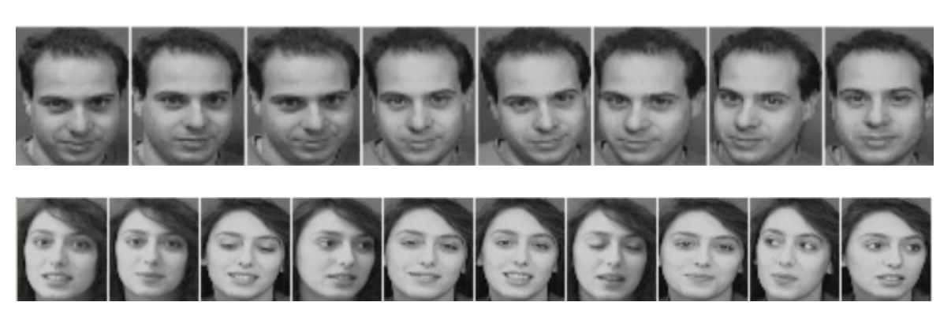
Example
What is a good lower dimensional representation of this data?
How can we find it?

Slide 14
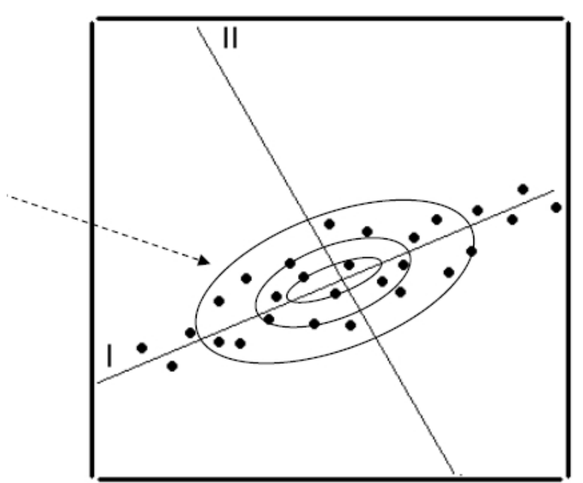
Principal Component Analysis (PCA)
PCA: the most popular method for dimensionality reduction
Goal: find the directions in input space that explain the most variation
Data is re-represented by projecting along those directions
Assumptions
The variation contains the information
The manifold model is a linear subspace
Components are linearly uncorrelated with each other

Slide 15
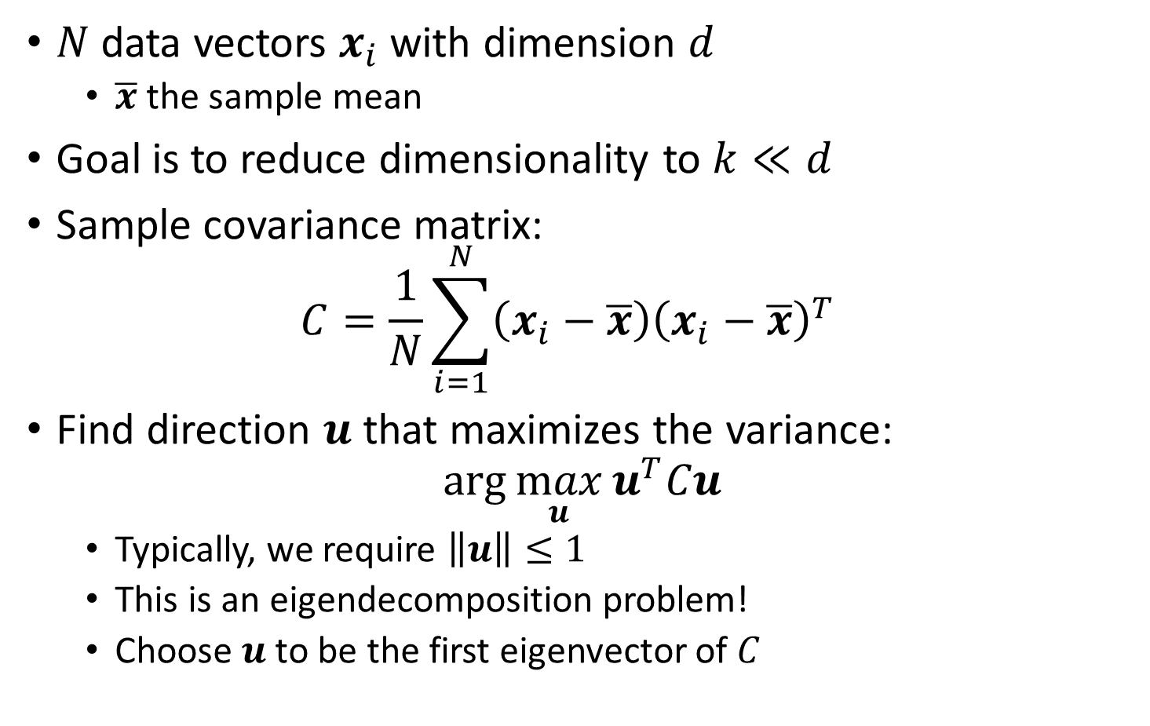
PCA: Maximize Variance
$N$ data vectors $x_{i}$ with dimension $d$
$\overline{x}$ the sample mean
Goal is to reduce dimensionality to $k≪d$
Sample covariance matrix: $C=\frac{1}{N}\sum_{i=1}^{N}{\left(x_{i}−\overline{x}\right){\left(x_{i}−\overline{x}\right)}^{T}}$
Find direction $u$ that maximizes the variance: $\arg{\max_{u}{u^{T}Cu}}$
Typically, we require $\left\|u\right\|≤1$
This is an eigendecomposition problem!
Choose $u$ to be the first eigenvector of $C$

Slide 16
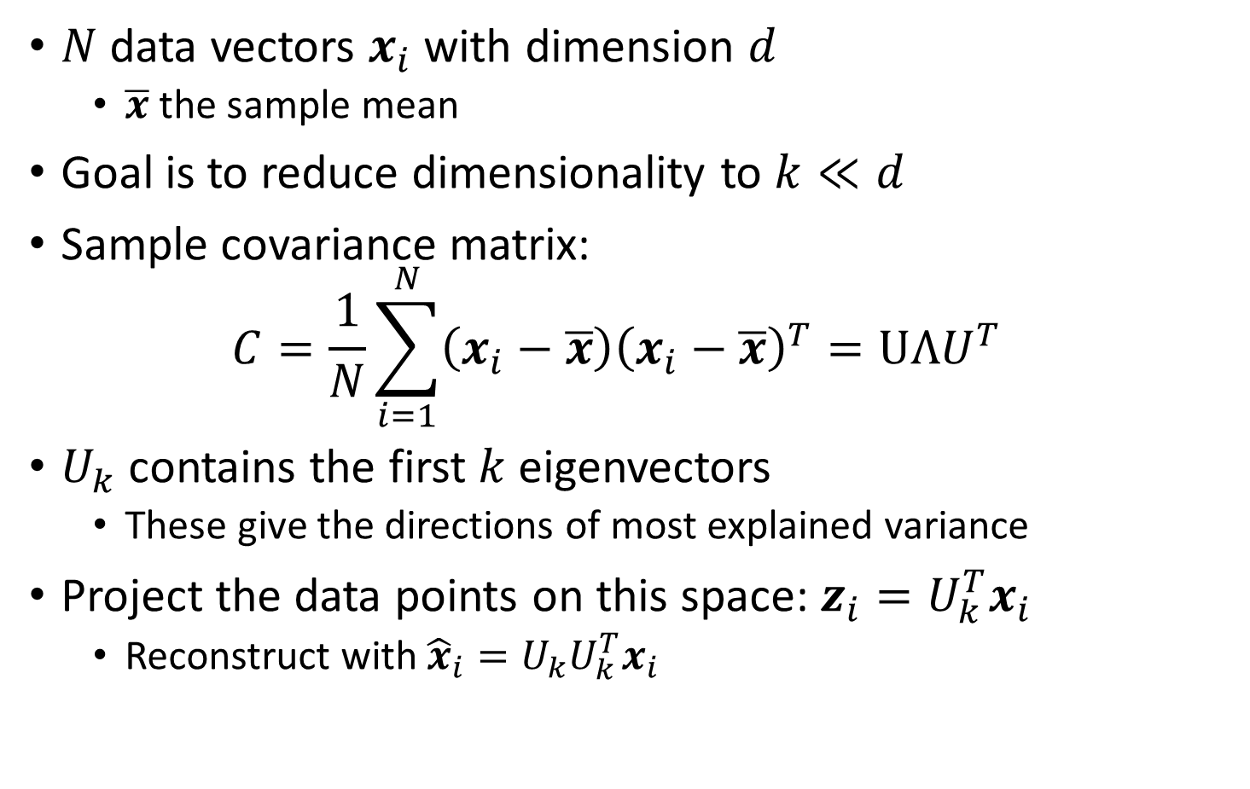
PCA: Maximize Variance
$N$ data vectors $x_{i}$ with dimension $d$
$\overline{x}$ the sample mean
Goal is to reduce dimensionality to $k≪d$
Sample covariance matrix: $C=\frac{1}{N}\sum_{i=1}^{N}{\left(x_{i}−\overline{x}\right){\left(x_{i}−\overline{x}\right)}^{T}}=UΛU^{T}$
$U_{k}$ contains the first $k$ eigenvectors
These give the directions of most explained variance
Project the data points on this space: $z_{i}=U_{k}^{T}x_{i}$
Reconstruct with ${\hat{x}}_{i}=U_{k}U_{k}^{T}x_{i}$
Notes:
This gives the lower dimensional representation

Slide 17
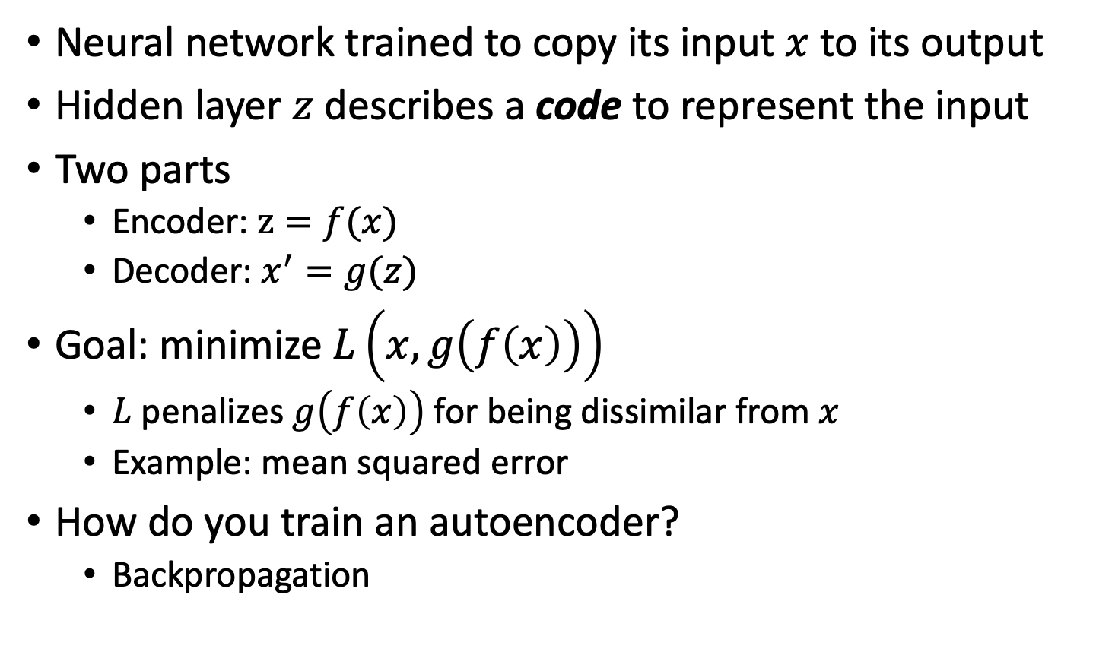
Autoencoder (AE)
Neural network trained to copy its input $x$ to its output
Hidden layer $z$ describes a code to represent the input
Two parts
Encoder: $z=f(x)$
Decoder: $x^{′}=g(z)$
Goal: minimize $L\left(x,g\left(f\left(x\right)\right)\right)$
$L$ penalizes $g\left(f\left(x\right)\right)$ for being dissimilar from $x$
Example: mean squared error
How do you train an autoencoder?
Backpropagation
Notes:
Autoencoders are special types of neural networks that have been used to do unsupervised and semi-supervised settings
Recirculation compares activations of the network on the original input to the activations on the reconstructed input (considered more biologically plausible)

Slide 18
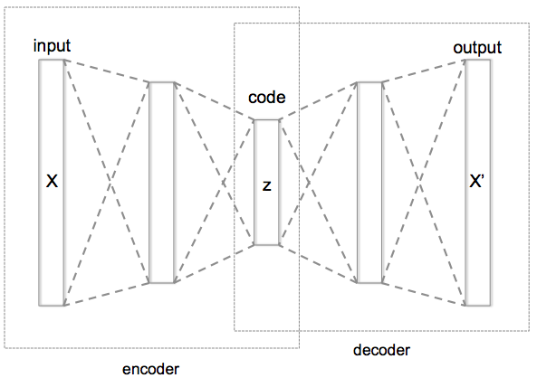
Autoencoder
Informational Bottleneck
Reconstruction Error
[Hinton, Salakhutdinov, Science 2006]
Notes:
Here is an example of an autoencoder. The autoencoder tries to reconstruct its input, after passing it through the layers of the network.
Notice that there is an informational bottleneck here that we’ll talk about in a second.

Slide 19
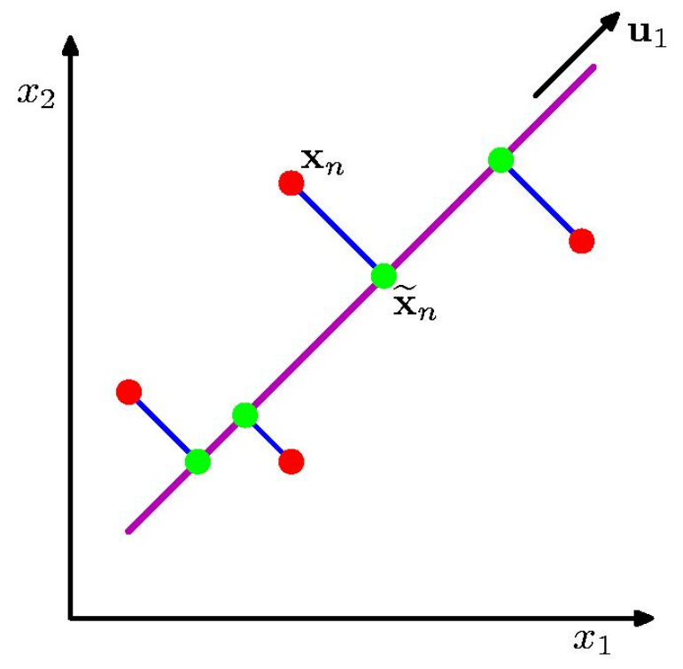
PCA: Two Views
Maximize variance (scatter of green points)
Minimize error (red-green distance per data point)

Slide 20
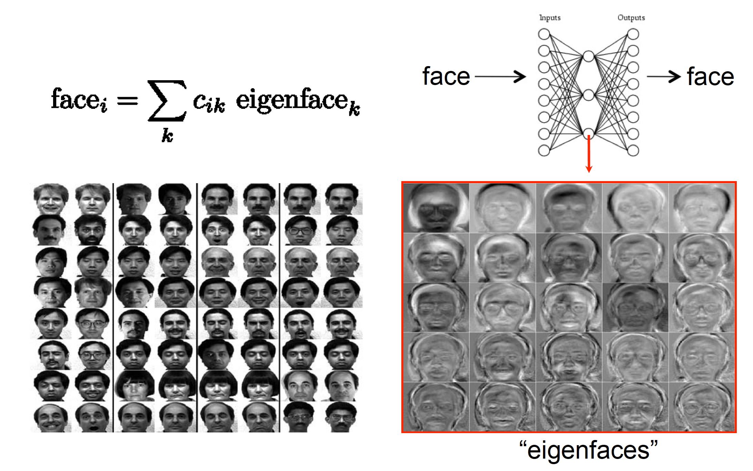
PCA as Minimizing Reconstruction Error

Slide 21
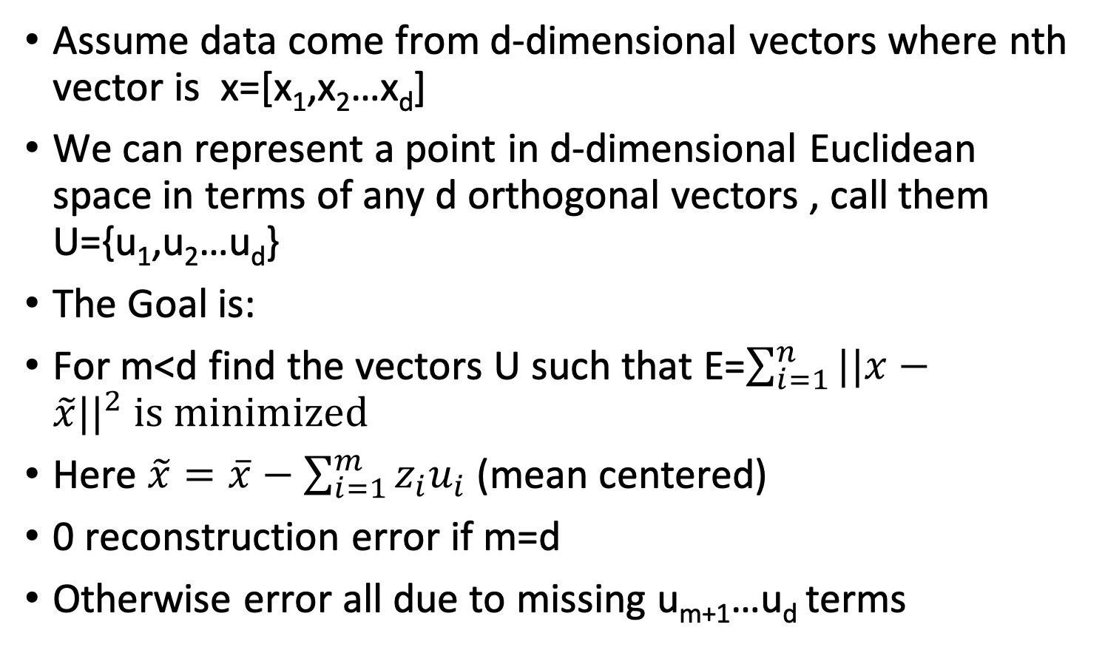
Reconstruction
Assume data come from d-dimensional vectors where nth vector is x=[x₁,x₂…x_{d}]
We can represent a point in d-dimensional Euclidean space in terms of any d orthogonal vectors , call them U={u₁,u₂…u_{d}}
The Goal is:
For m<d find the vectors U such that E=$\sum_{i=1}^{n}{||x−}$ $\tilde{x}{||}^{2} is minimized$
Here $\tilde{x}=\overline{x}−\sum_{i=1}^{m}{z_{i}u_{i}}$ (mean centered)
0 reconstruction error if m=d
Otherwise error all due to missing u_{m+1}…u_{d} terms

Slide 22
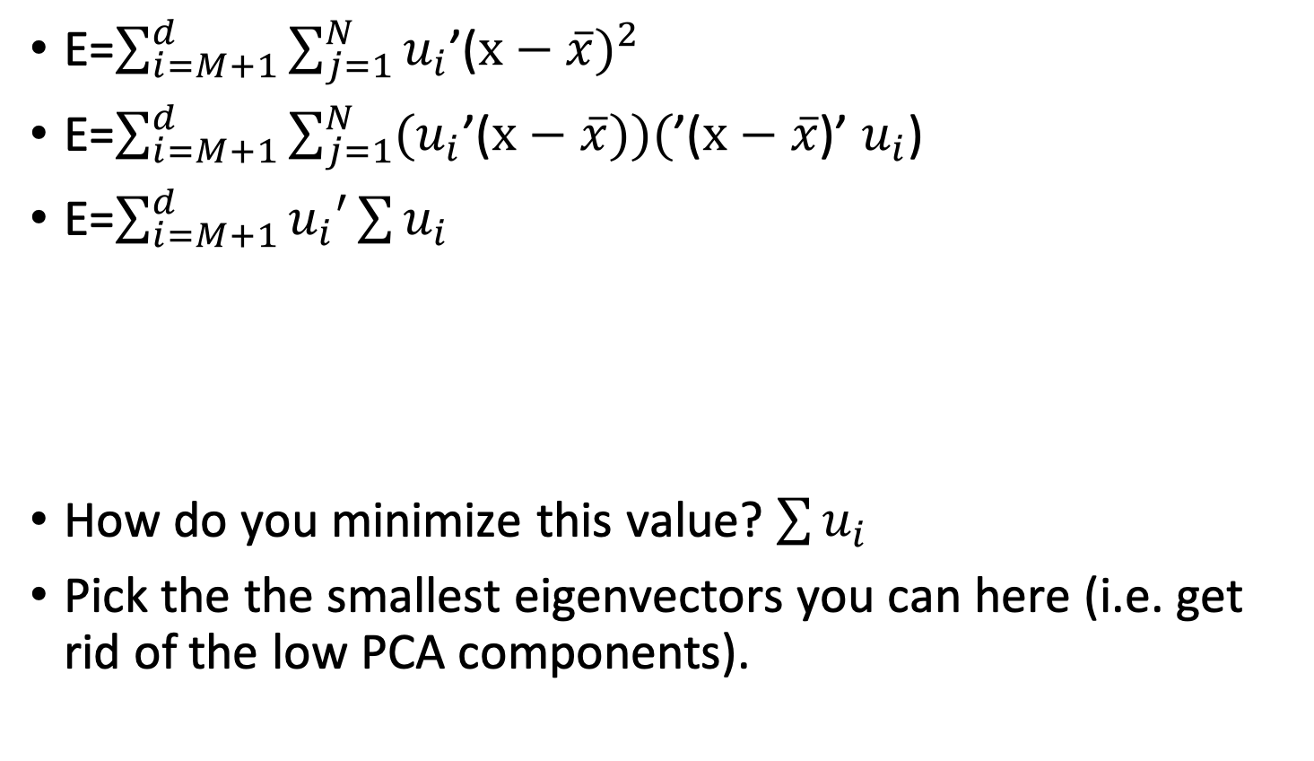
Reconstruction
E=$\sum_{i=M+1}^{d}{\sum_{j=1}^{N}{u_{i}}}$’($x−\overline{x})^{2}$
E=$\sum_{i=M+1}^{d}{\sum_{j=1}^{N}{{(u}_{i}}}$’($x−\overline{x}))($’($x−\overline{x}$)’ $u_{i}$)
E=$\sum_{i=M+1}^{d}{u_{i}′}\sum{u_{i}}$
How do you minimize this value? $\sum{u_{i}}$
Pick the the smallest eigenvectors you can here (i.e. get rid of the low PCA components).
Covariance matrix

Slide 23
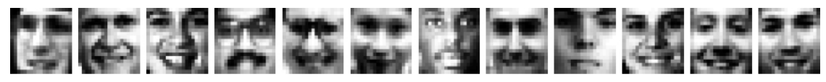
PCA on facial images
PCA applied to 2429 $19×19$ images from CBCL dataset
Reconstruction with only 3 components:

Slide 24
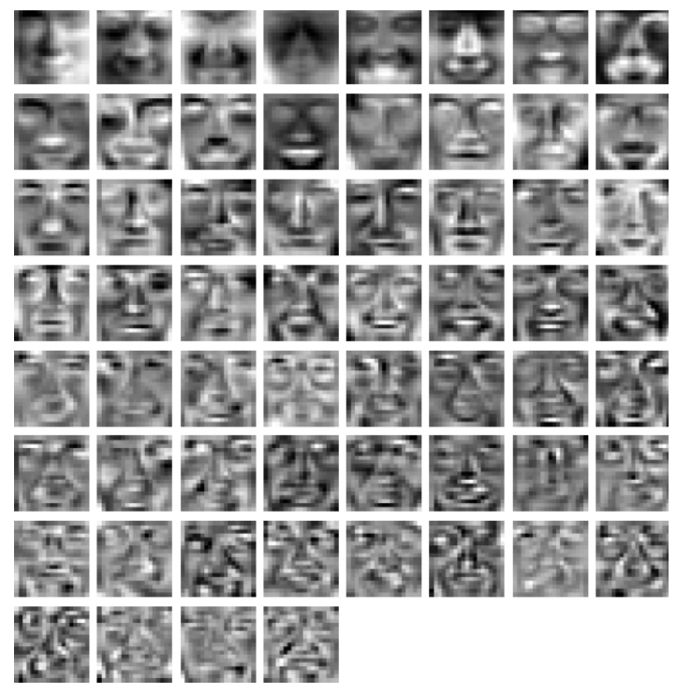
PCA on facial images
The principal components

Slide 25
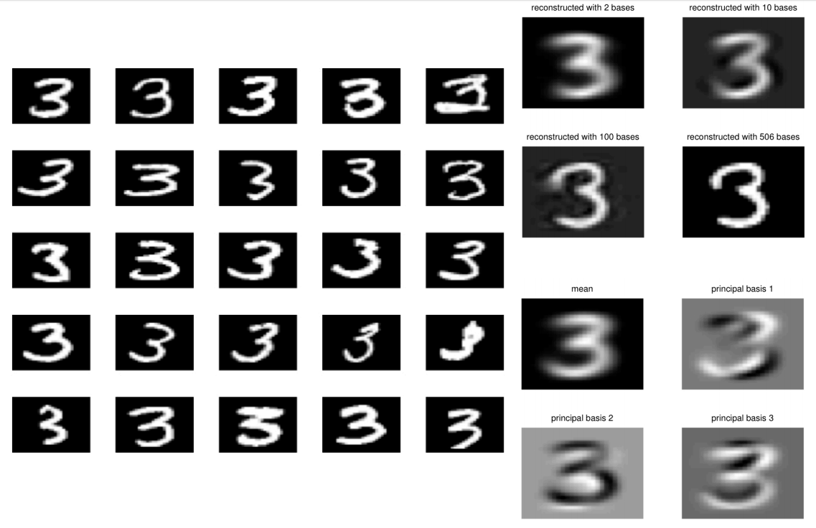
PCA on MNIST

Slide 26
Non-linear dimensionality reduction

Slide 27
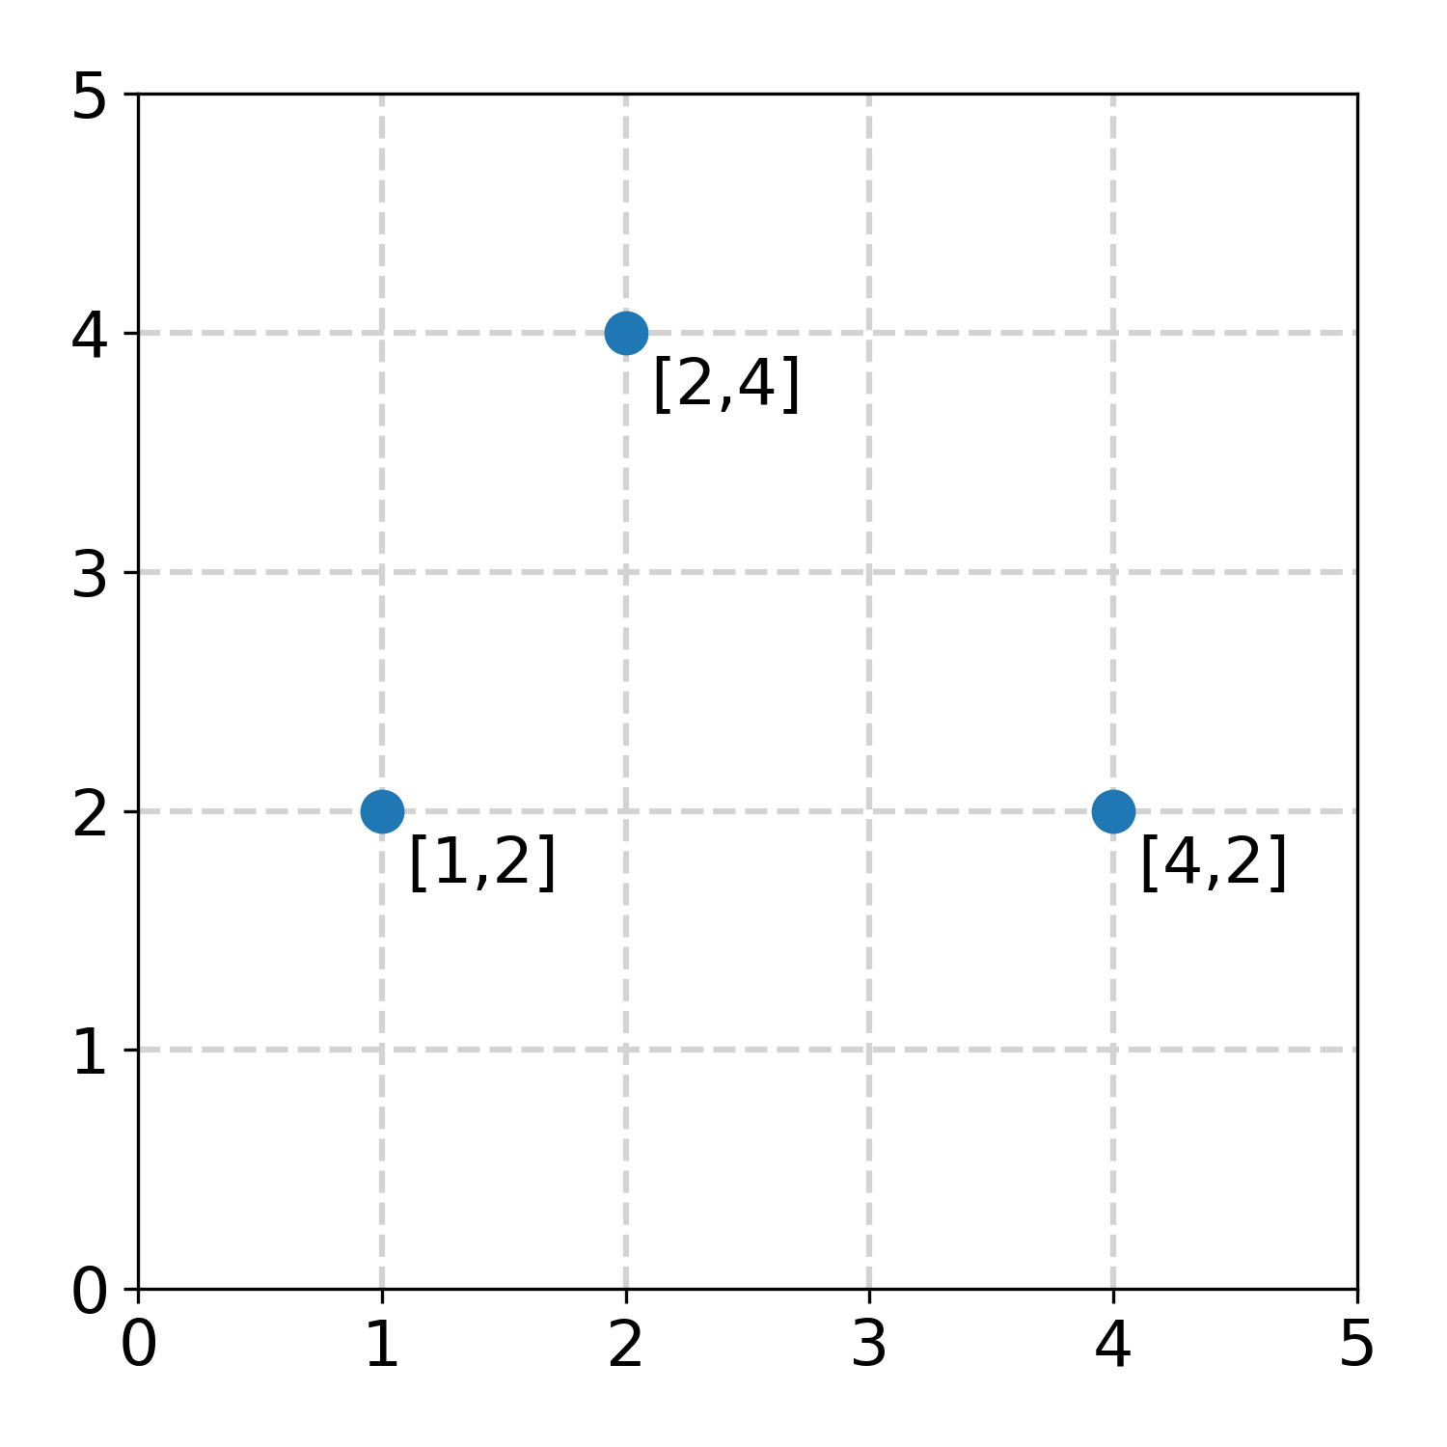
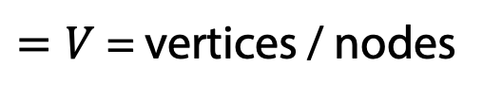
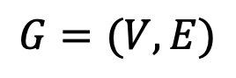
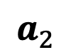
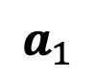
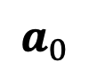
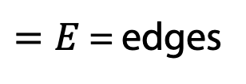
Representing Data as a Graph
Plot
Graph
$$a_{1}$$
$$a_{0}$$
$$a_{2}$$
$$G=(V,E)$$
$=V$ = vertices / nodes
$=E$ = edges

Slide 28
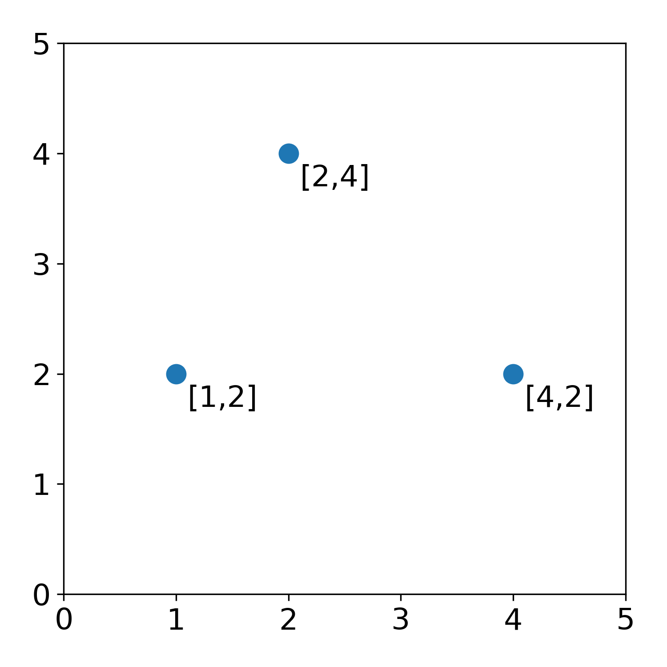
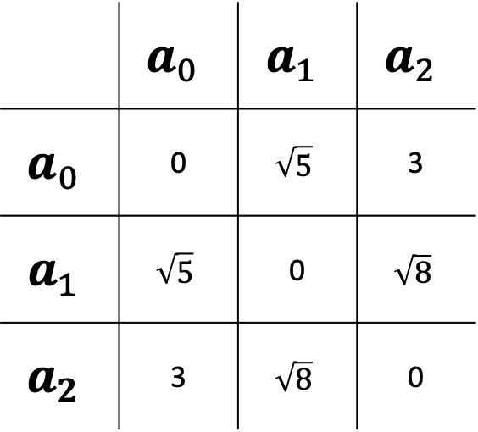
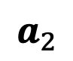
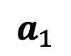
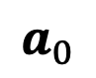
Fully connected Graph
 | $$a_{0}$$ | $$a_{1}$$ | $$a_{2}$$
$$a_{0}$$ | 0 | $$\sqrt{5}$$ | 3
$$a_{1}$$ | $$\sqrt{5}$$ | 0 | $$\sqrt{8}$$
$$a_{2}$$ | 3 | $$\sqrt{8}$$ | 0
$$a_{1}$$
D(0,1)
D(1,2)
$$a_{0}$$
$$a_{2}$$
D(0,2)
Distance matrix

Slide 29
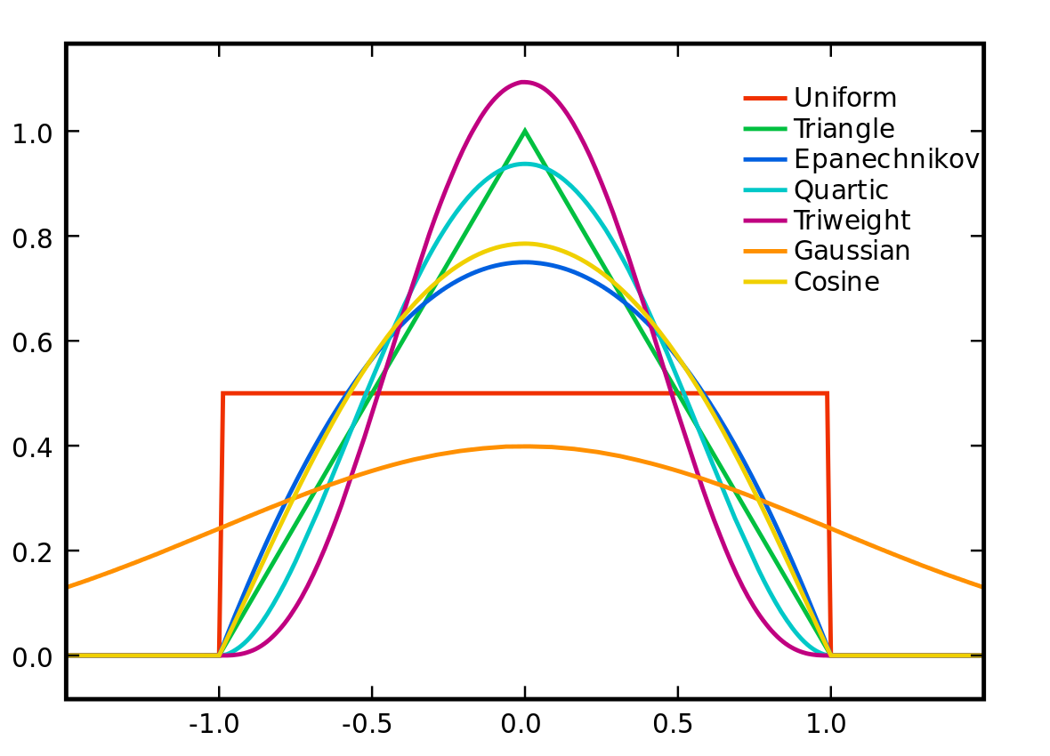
Distance to Affinity via Kernels
Real-valued
Non-negative
Symmetric
Affinities correlations in this hidden hypothetical space

Slide 30
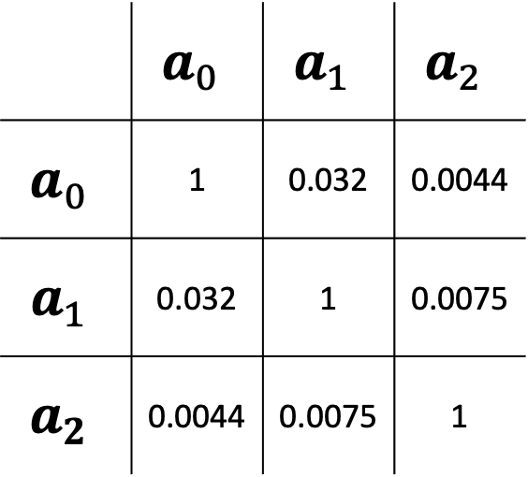
Affinities
 | $$a_{0}$$ | $$a_{1}$$ | $$a_{2}$$
$$a_{0}$$ | 1 | 0.032 | 0.0044
$$a_{1}$$ | 0.032 | 1 | 0.0075
$$a_{2}$$ | 0.0044 | 0.0075 | 1
$$a_{1}$$
A(0,1)
A(1,2)
$$a_{0}$$
$$a_{2}$$
A(0,2)
Affinity or Adjacency Matrix

Slide 31
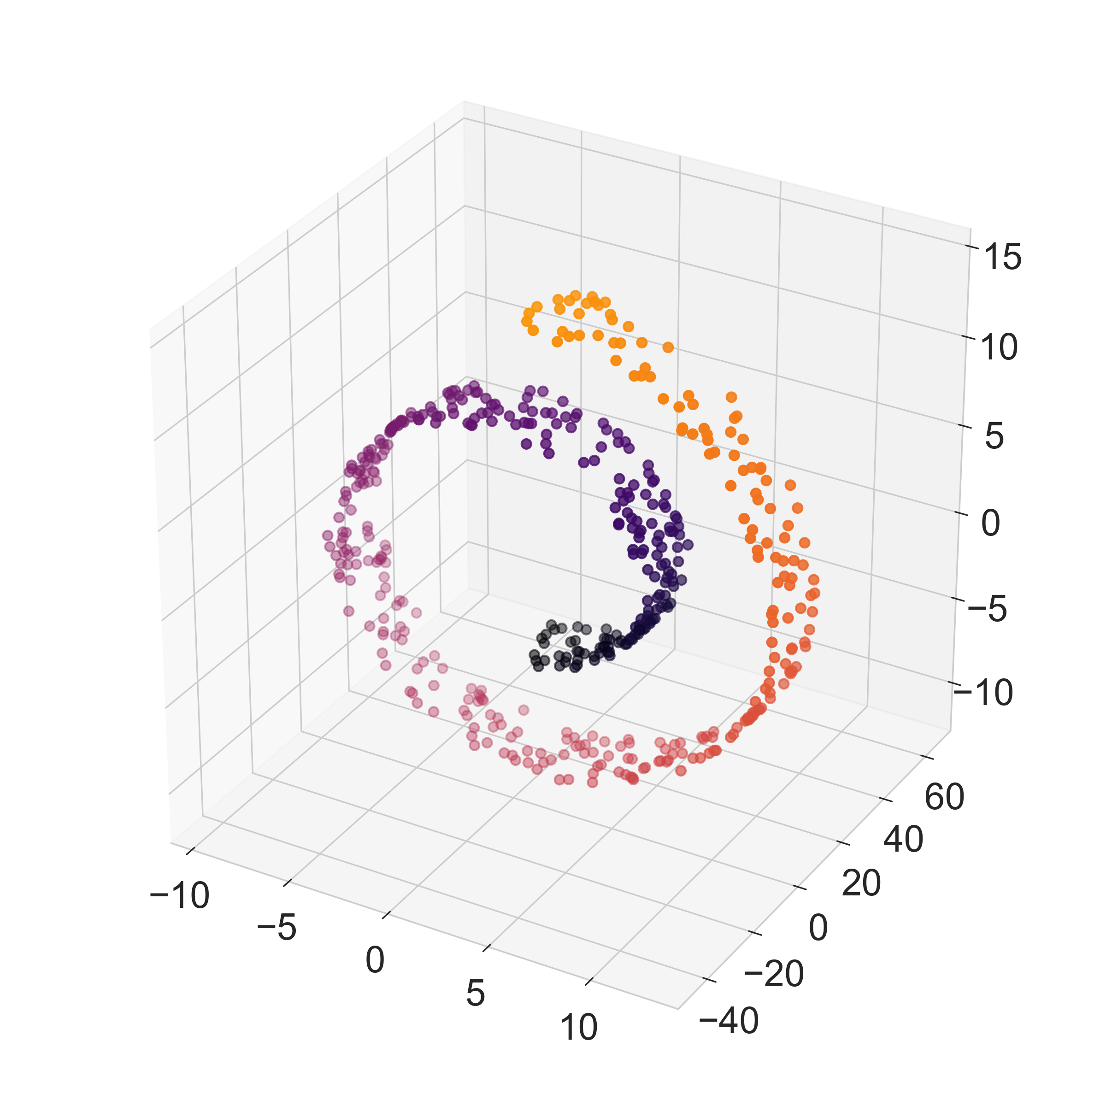
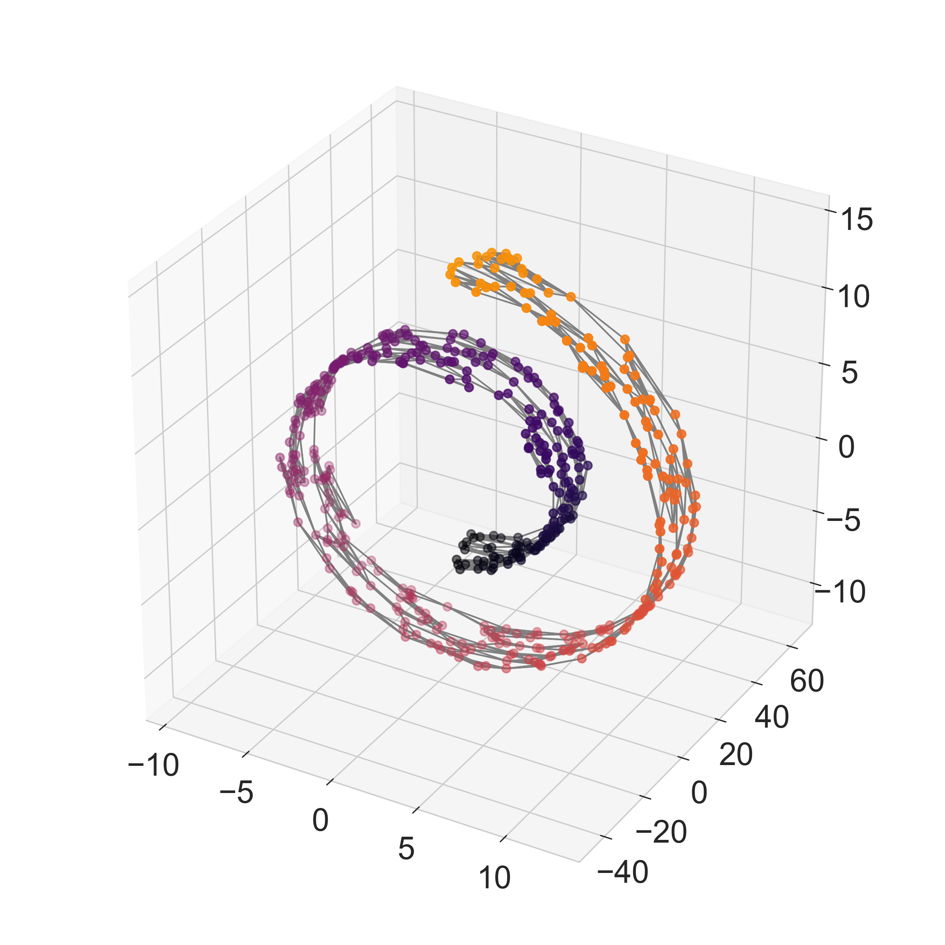
Nearest Neighbors Graph
Data
Nearest Neighbor Graph
Edge

Slide 32
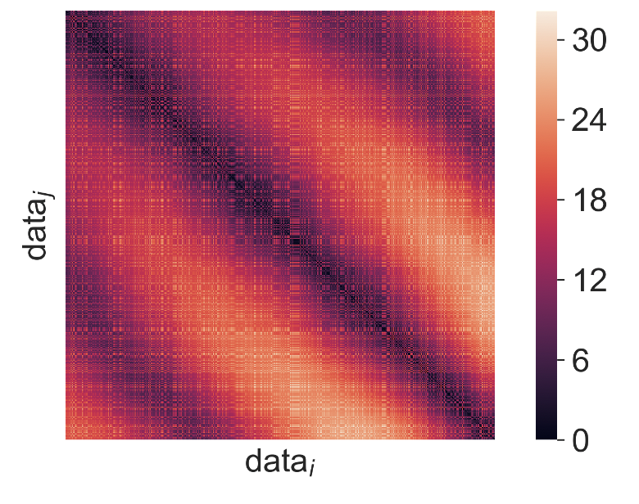
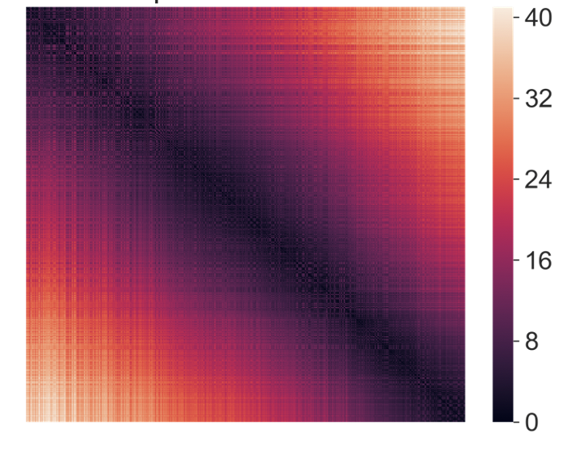
Swiss Roll
Distances
Affinities
Notes:
Point out that A2 would be “sort of close” in Euclidean space

Slide 33
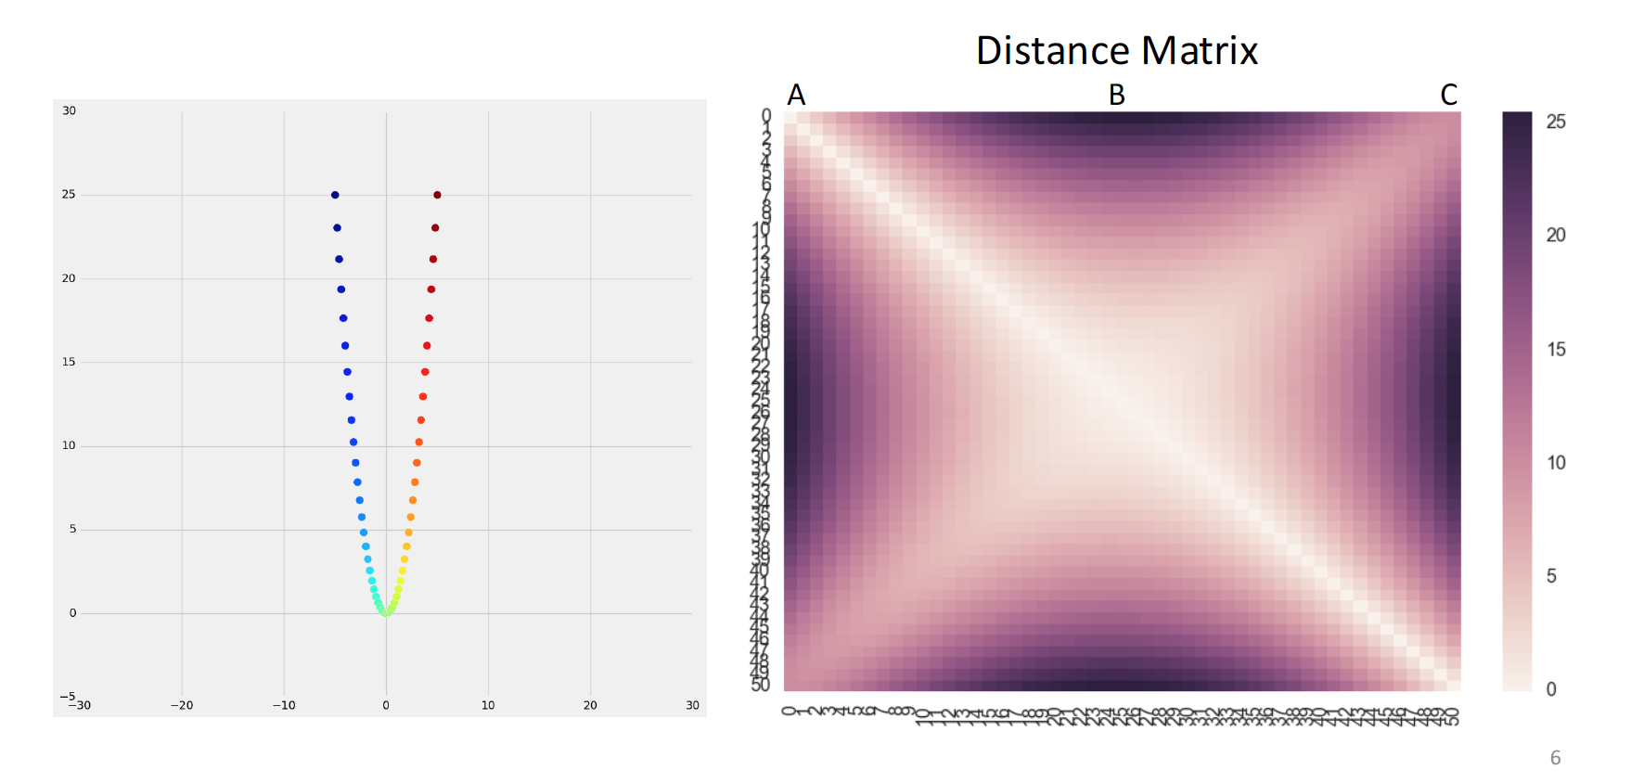
Example

Slide 34
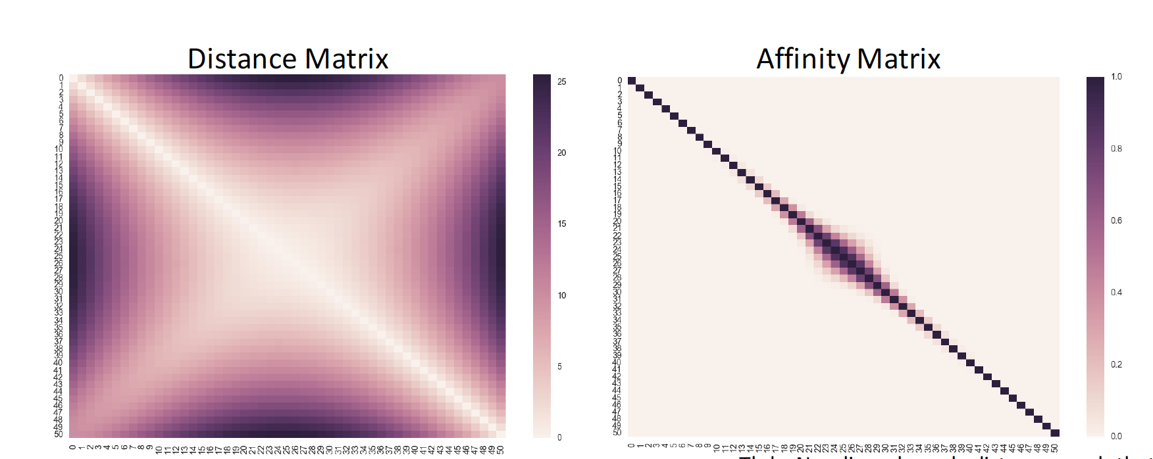
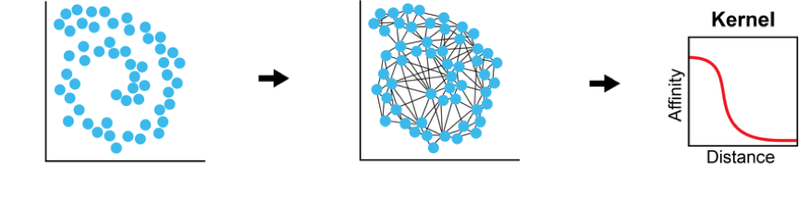
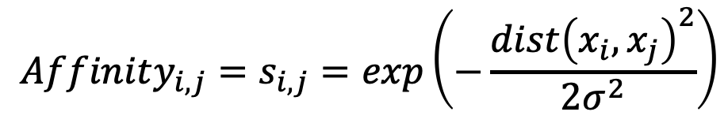
Affinity is the inverse proportional to distance
$$Affinity_{i,j}=s_{i,j}=exp\left(−\frac{dist{\left(x_{i}, x_{j}\right)}^{2}}{2σ^{2}}\right)$$

Slide 35
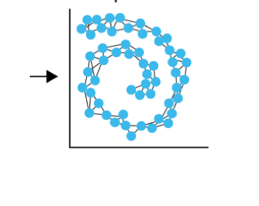
Kernel PCA
data
distances
Affiniities
Use eigenvectors of an affinity matrix instead of covariance matrix
The family of methods called kernel PCA:
Specific variants include:
Laplacian Eigenmaps
Diffusion Maps

Slide 36

Diffusion Maps
Data in high
dimensions
Eigendecomposition gives principal axes of manifold structure

Slide 37

Diffusion Maps
Coifman, Lafon 2006
[Coifman, Lafon, ACHA 2006]

Slide 38





Eigenvectors are frequency harmonics
2nd Eigenvector
10th Eigenvector
2nd to last eigenvector

Slide 39

Example Embedding

Slide 40


Lips Dataset: Spoken Digits
ONE

Slide 41

Lips Manifold
Opening of mouth
portion of teeth
visible

Slide 42
Autoencoder Applications
Dimensionality reduction
Including visualization
Data denoising
Also…
Feature learning
Information retrieval
Data compression
Data generation

Slide 43

Are Autoencoders useful?
Can’t we just set $g\left(f\left(x\right)\right)=x$ everywhere?
Not very useful
Design the AE so it can’t learn to copy the input perfectly
Restrict the AE to copy only approximately
Can prioritize certain aspects of the input
Examples
Restrict the size of the code (i.e. add a bottleneck)
Add regularization

Slide 44

Camera Obscura
Input
Encoder
Hidden Representation
Decoder
Camera Obscura, the renaissance autoencoder
Notes:
We can use the Camera Obscura as an analogy for the autoencoder. The scenery is in the input data. The pinhole is the encoder that creates a representation of the data by projecting it. The painter is the decoder that tries to recreate the image from the encoded representation as best as possible.
The encoder and decoder are a set of layers that act as an informational bottleneck, which is achieved by various types of regularizations or the architecture of the AE.

Slide 45

Undercomplete Autoencoders
Hope: training the autoencoder will result in $z$ having useful properties
Dim$\left(z\right)<$ Dim$\left(x\right)⇒$ undercomplete autoencoder
Forces the AE to capture the most salient features of the training data
The AE only approximately copies the input (lossy compression)

Slide 46


Undercomplete Autoencoders
Special case: Linear decoder, mean squared error loss
Example: single hidden unit
What will this learn?
$\hat{x}=w^{T}wx$
Recall $w$ is a row vector
Minimize reconstruction error:
$$\hat{w}=\arg{\min_{w}{𝔼\left[{\left\|x−w^{T}wx\right\|}^{2}\right]}}$$
Equivalent to PCA!

Slide 47


Undercomplete Autoencoders
What about more hidden nodes?
$Y=WX$, $\hat{X}=W^{T}Y$
Find $W$ to minimize $𝔼\left[{\left\|X−W^{T}WX\right\|}^{2}\right]$
Still PCA

Slide 48

Undercomplete Autoencoders
Special case: Linear decoder, mean squared error loss
Undercomplete AE learns to span the same subspace as PCA
The AE has learned the principal subspace of the training data
Nonlinear encoder and decoder functions can give powerful nonlinear generalization of PCA
Be careful with capacity
Too much capacity $⇒$ AE learns to copy the input w/o extracting useful information
Example: could learn a 1-dimensional code for the entire dataset
Map each training example $x_{i}$ to the integer $i$
Nothing useful is learned in this case

Slide 49
Regularized Autoencoders
Undercomplete AEs can fail to learn anything useful if the capacity is too large
Same problem if the hidden code is dimension equal to or greater than the input dimension
Latter case gives an overcomplete AE
Even linear encoder and decoder wouldn’t be useful
Regularized AEs modify the loss function to encourage desirable properties
E.g., sparsity, robustness to noise
Regularized nonlinear and overcomplete AE can still learn something useful about the data distribution
Notes:
Meaning, the complexity of mappings from layer to layer is too large
For linear case, they could learn to copy the input exactly

Slide 50

AE MNIST

Slide 51

Document Embedding

Slide 52

Autoencoding MNIST

Slide 53


Autoencoding MNIST
Single hidden layer with 32 nodes, fully connected layers
Cross-entropy loss per pixel, ReLU activations
Train for 50 epochs
Reaches a stable train/test loss of 0.11
Top $=$ original, bottom $=$ reconstructed digits

Slide 54


Autoencoding MNIST
Single hidden layer with 32 nodes, fully connected layers
Cross-entropy loss per pixel, ReLU activations
Add L1 sparsity penalty to hidden layer
Train for 100 epochs
Train loss 0.11, test loss 0.10
Top $=$ original, bottom $=$ reconstructed digits
Look the same, but sparser code

Slide 55


Autoencoding MNIST
Add two other hidden layers on each side of size 128 & 64
Cross-entropy loss per pixel, ReLU activations
Train for 100 epochs
Train/test loss $≈0.097$
Top $=$ original, bottom $=$ reconstructed digits

Slide 56


Autoencoding MNIST
Convolutional autoencoder
Loss of 0.094
Top $=$ original, bottom $=$ reconstructed digits

Slide 57

Sparse Autoencoders
Commonly used for feature learning for another task
Include a sparsity penalty $Ω\left(z\right)$ on the code layer $z$: $L\left(x,g\left(f\left(x\right)\right)\right)+Ω\left(z\right)$
Recall, encoder output $z=f(x)$, decoder output $g\left(z\right)$
Example: L1 penalty
$Ω\left(z\right)=λ\sum_{i}{\left|z_{i}\right|}$
To achieve actual zeros, use ReLU activation prior to the code layer
Notes:
Example is classification

Slide 58



Denoising Autoencoders
Traditional AE minimizes $L\left(x,g\left(f\left(x\right)\right)\right)$
Denoising autoencoder minimizes $L\left(x,g\left(f\left(\tilde{x}\right)\right)\right)$
$\tilde{x}$ is a corrupted version of $x$
Denoising AEs learn to undo this corruption
Corruption process $C\left(\tilde{x} | x\right)$ modeled by conditional distribution
The AE learns a reconstruction distribution $p_{reconstruct}\left(x | \tilde{x}\right)$ from training pairs $\left(x,\tilde{x}\right)$
$$z$$

Slide 59

Denoising Autoencoders
The process:
Sample training example $x$ from training data
Sample corrupted version $\tilde{x}$ from $C\left(\tilde{x} | x\right)$
Use $\left(x,\tilde{x}\right)$ as a training example for estimating $p_{reconstruct}\left(x | \tilde{x}\right)=p_{decoder}\left(x | z\right)$
$z=f\left(\tilde{x}\right)$ the encoder output, $p_{decoder}$ defined by decoder $g\left(z\right)$
Can perform SGD on the negative log-likelihood $−\log{p_{decoder}\left(x | z\right)}$
Equivalent to doing SGD on $−𝔼_{x\sim p_{data}\left(x\right)}𝔼_{\tilde{x}\sim C\left(\tilde{x} | x\right)}\log{p_{decoder}\left(x | z=f\left(\tilde{x}\right)\right)}$
$p_{data}$ is the training distribution

Slide 60

Denoising Autoencoders
Notes:
Red points are the training data, green arrows indicate the correction back.

Slide 61

Application to Image Denoising

Slide 62


Autoencoding MNIST
Denoising autoencoder
Add Gaussian noise
Top $=$ noisy original, bottom $=$ reconstructed digits

Slide 63
Further reading
Goodfellow et al., chapter 14
Hinton and Salakhutdinov Science 2006
Coifman and Lafon Applied and Computational Harmonic Analysis 2006
Belkin & Niyogi, Neural Computation 2003
Alain & Bengio, JMLR 2014

